Slide 1
Why Am I Always Late? Or Is It Early? Why Are Dates So Hard?
Dan Mallott

Slide 2




















































Titanium Sponsors
Speaker Dinner Sponsor
Platinum Sponsors
Gold Sponsors

Slide 3

DAN MALLOTT
1
SENIOR PRINCIPAL FOR WEST MONROE
2
DEVELOPING SOFTWARE SINCE 2011
3
STARTED AS A DBA – NOW A DEVELOPER
4
PRIMARY EXPERIENCE WITH MICROSOFT TECHNOLOGIES
5
ALSO, A USA HOCKEY REFEREE
Twitter: @DanielMallott
GitHub: https://github.com/danielmallott
LinkedIn: https://www.linkedin.com/in/danielmallott
Notes:
Show the # of ideas in each phase so we focus more on

Slide 4
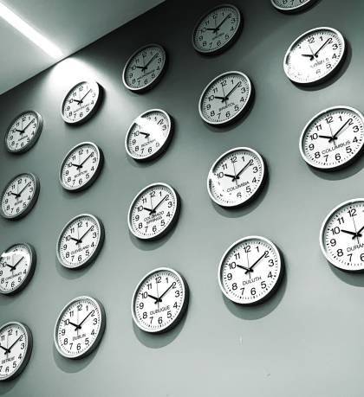
Why are We here
Date and Time Fallacies
Storage – Simple, Right?
Typing in .NET 6
Display to the User…Eek!
Remediation

Slide 5
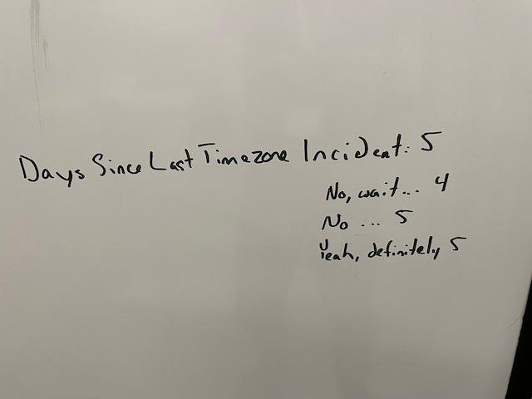

Slide 6
What If I Told You CDT and EST Were the Same?

Slide 7
Problem #1: Time Zones
UTC offsets range from -12 to +12 in increments of 1
Okay, increments of 0.5...
Every offset corresponds to exactly one time zone (name)
A country or area stays at the same UTC offset for the entire year
Fine, their UTC offset changes at the same time(s) every year…
At least their UTC offsets always change by exactly 1 hour

Slide 8
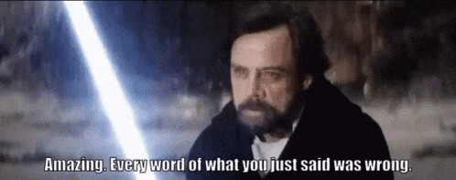

Slide 9
The Truth
1
UTC offsets actually range from -12 to +14 and increment by 0.25 (in some cases, like Nepal, the Chatham Islands, Eucla)
2
Offsets can correspond to many individual time zones (e.g., UTC+5 has 10 named time zones)
3
The Americas and Europe enjoy Daylight Saving Time (or Summer Time), which changes the offset for those areas
4
We know that those changes aren’t always at the same time every year
5
Lastly, believe it or not, DST offsets are not always 1 hour (Lord Howe Island shifts by 30 minutes)

Slide 10
This is terrible, right?

Slide 11
Just store everything in UTC – that will fix it, right?

Slide 12
Well, kind of…

Slide 13
Storing Dates in UTC
Past Dates
Future Dates
Storing historical dates as UTC is generally accepted to be the best practice. If you want to (reliably) display the time as it was at that moment, strongly consider also storing the offset (and potentially the entire local time)
NOTE: Not the time zone name – this might be meaningless over time
Storing future dates as UTC is a recipe for more problems, especially where user input is concerned, even if you store the intended offset – because time zones do change. What happens when the US Congress switches when Daylight Saving Time begins and ends again? Your carefully crafted future time will now be off by one hour…
Store user-entered or controlled future times in the time zone they were entered in - this is the intended time, so preserve it, no matter what the world does to mess with us

Slide 14
How Do I Store That?

Slide 15
Problem #2: Storing Time
Okay, so we need to store in both time zone aware and not time zone aware storage (and maybe an offset)
Don’t need to know about time zone? Use DATETIME/DATETIME2/TIME
Need to know about time zone? Use DATETIMEOFFSET
Don’t need to know about time zone when generating? GETDATE() or SYSDATETIME()
Need to know about time zone when generating? SYSDATETIMEOFFSET()
Oh, and that standalone offset? DECIMAL (I guess?)

Slide 16
How Do I Consume That?

Slide 17
Problem #2 (part 2): Consuming Time
Great, we’re storing time zone (or not) times. How do I consume those in code?
C# has some answers for us
Don’t need to know about time zone? The old standby: System.DateTime or, even better, System.TimeOnly
Need to know about time zone? Meet my friend: System.DateTime Offset

Slide 18
How Do I Construct That?

Slide 19
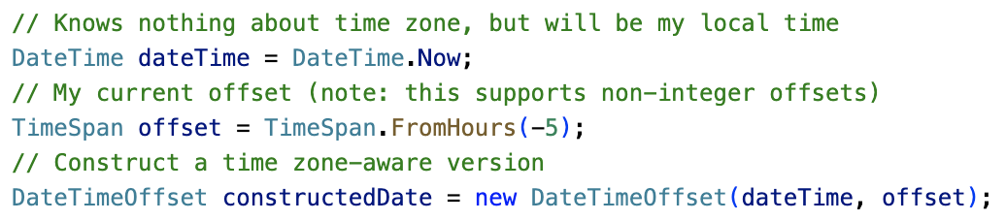
Using System.DateTimeOffset

Slide 20
But…Do You Actually Need a Full Date and Time Object?

Slide 21
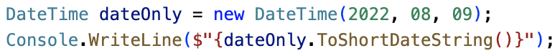
Problem #3: Irrelevant date and time data
How do you handle the case where you only need a date or a time?
In SQL Server, we have had standalone DATE and TIME types since 2008
In .NET, we have only had System.
DateTime (and, starting in 2.0 System.
DateTimeOffset)
But we end up carting around data we don’t need, writing code like the below

Slide 22
But Not Anymore!

Slide 23
Introducing: System.DateOnly and System.TimeOnly
New with .NET 6.0, we have two new date and time types for storing only Dates or only Times
System.DateOnly stores only the date component of a System.DateTime, with the same range
System.TimeOnly stores only the time component of a System.DateTime, with a modified range, and should be preferred to System.TimeSpan for new development
Store and hold in memory, only the data you actually need!
Date and Time best practices

Slide 24
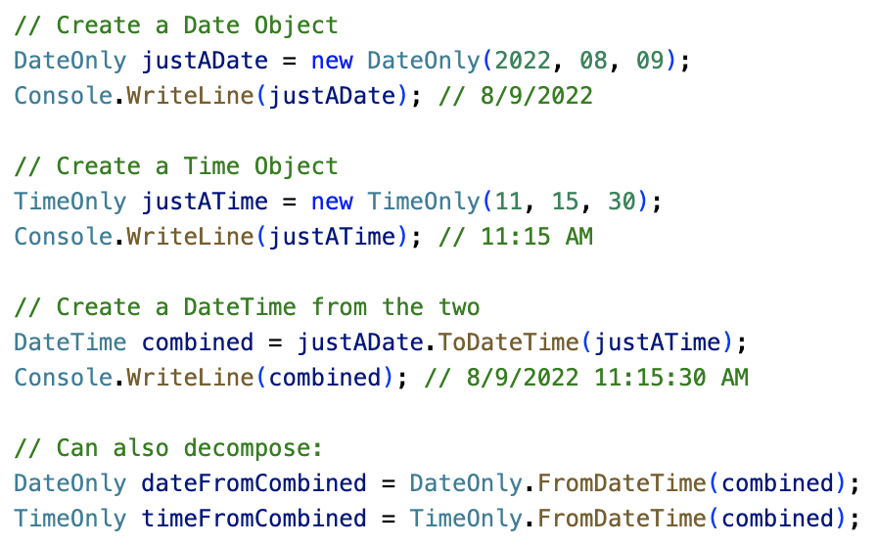
So How Do These Work?

Slide 25
All This Server Stuff Is Great – What About the Browser?

Slide 26
Problem #4: Display to the User
If you are storing dates in UTC (or the user’s time zone), and you don’t have to customize the display time zone, JavaScript handles this reasonably well
But! If you allow users to configure the time zone they would like to display things in, make sure you are passing offset information on every call! From there, it’s a (relatively) straightforward set of JavaScript to figure out the proper date and time
Or you can use moment.js or date-fns
Oh, and this is a great thing to make sure you unit test

Slide 27
But What If I Already Have
Time-related Challenges?

Slide 28
Problem #5: It’s Already Messed Up
So, you already have time-related issues, whether that be hacky display logic, or time stored without time zone information (but we’re sure it’s local…to somewhere) in the database
What is there to do?

Slide 29
Step 1:
Do it right from here on out (which may mean refactoring)

Slide 30
Step 2:
Fix your historical data…if you can

Slide 31
What if fixing the historical data is impossible?
1
The answer depends on what the data represents (and how regulated your company is)
2
If you need to retain the actual time something happened (for audit purposes or financial purposes), you are going to have to do some research about how the system was built and the decisions made back then
3
If you don’t need to retain the actual time, it’s a reasonable assumption that the time zone of the server has always been what the data has been created in – just convert to UTC and move on
4
Whatever you do, document the crap out of it and get sign off from every consumer of the data (maybe except customers)

Slide 32
Questions?

Slide 33
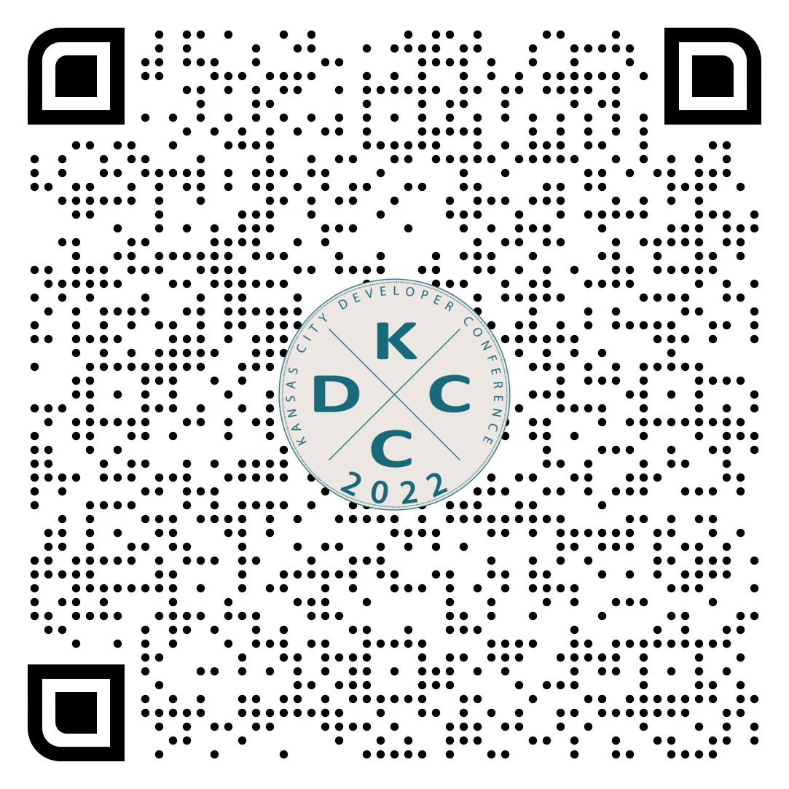
Thank you!
@danielmallott
https://github.com/danielmallott
https://linkedin.com/in/danielmallott

